Slide 1

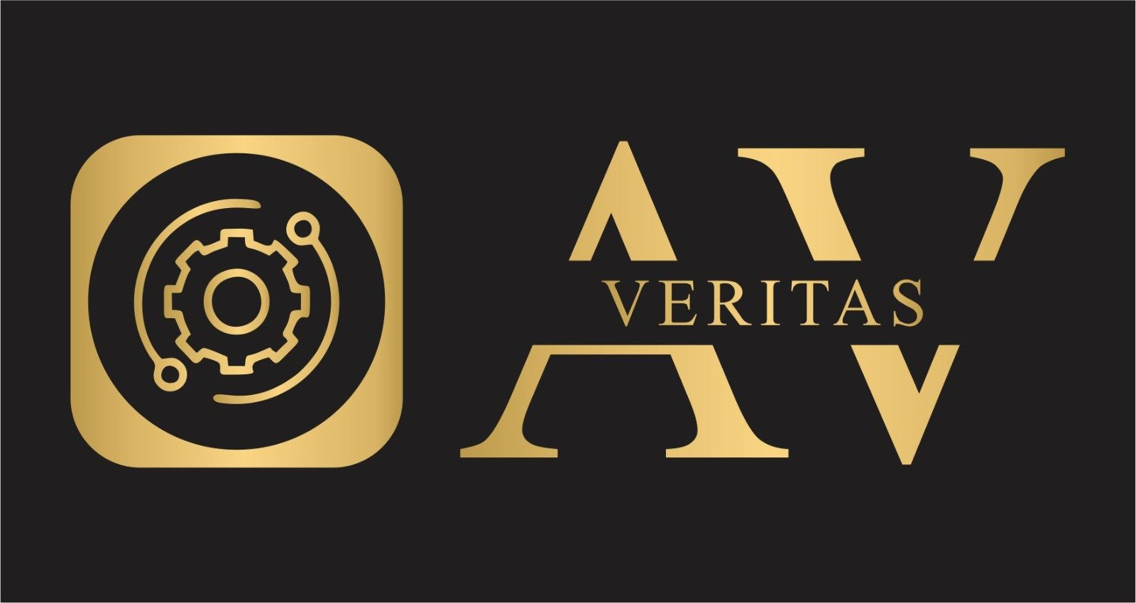
AV VERITAS
Plot No 3-4, S/F, BLOCK K, Rajapuri Uttam Nagar Delhi 110059
info@veritasav.org.in
Empowering Businesses with Smart IT Solutions
Your trusted partner for comprehensive IT infrastructure solutions across SMEs and educational institutions

Slide 2

Empowering Businesses with Smart IT Solutions
Your Technology Partner
We deliver comprehensive IT infrastructure solutions that transform how businesses and educational institutions operate in the digital age.
Vision: To be the leading provider of innovative IT solutions that drive organizational success.
Mission: Empowering organizations with reliable, secure, and scalable technology infrastructure.
Innovation
Reliability
Cutting-edge solutions
99.9% uptime guarantee
Security
Customer-Centric
Enterprise-grade protection
Tailored solutions

Slide 3






Comprehensive IT Expertise
From hardware deployment to advanced security solutions, we deliver complete IT infrastructure services tailored to your organization's needs.
Hardware & Networking
Network Security
Complete infrastructure setup and management
Advanced threat protection and data safety
Wireless Solutions
Applications & Websites
Campus-wide connectivity and mobility
Custom software and digital platforms
CCTV & Surveillance
Smart Classrooms
Comprehensive monitoring systems
Interactive learning environments

Slide 4

Why Choose Our Solutions
10+
15+
Years Experience
Successful Projects
Proven track record in IT infrastructure
Delivered across multiple industries
24/7
Support Available
Round-the-clock technical assistance
Industry-Certified Team
End-to-End Solutions
Proven Success Stories
Cisco, Microsoft, and other leading technology certifications ensure expert-level service delivery
From initial consultation to ongoing maintenance, we handle every aspect of your IT infrastructure
Our clients report 40% improved efficiency and 60% reduction in IT-related downtime

Slide 5

Hardware & Networking Excellence
Complete Infrastructure Solutions
We handle every aspect of your hardware and networking needs, from initial design to ongoing maintenance.
Professional installation and configuration of PCs, laptops, and printers
Custom LAN/WAN design and implementation for optimal performance
Structured cabling solutions meeting industry standards
Network optimization and performance monitoring
01
02
Assessment & Design
Implementation
Comprehensive evaluation of your current infrastructure and future needs
Professional installation with minimal disruption to operations
03
04
Testing & Optimization
Ongoing Support
Thorough performance testing and fine-tuning for peak efficiency
Continuous monitoring and maintenance to ensure optimal performance

Slide 6




Network Security Solutions
Protecting Your Digital Assets
In today's threat landscape, robust security isn't optional—it's essential. Our comprehensive security solutions safeguard your organization's critical data and operations.
Firewall & VPN Solutions
Data Protection & Backup
Enterprise-grade perimeter defense with secure remote access capabilities for distributed teams
Automated backup systems with cloud integration ensuring 99.9% data recovery guarantee
Threat Detection & Prevention
AI-powered monitoring systems that identify and neutralize threats before they impact operations
"Our multi-layered security approach has prevented 100% of attempted breaches across our client base in the past 18 months."

Slide 7


Wireless Campus Solutions
Seamless Connectivity Across Your Campus
Whether you're managing a corporate campus or educational institution, our wireless solutions deliver high-speed, secure connectivity that scales with your needs.
Enterprise Wi-Fi Coverage
High-Speed Performance
Wall-to-wall wireless coverage for schools, colleges, and corporate facilities with zero dead zones
Gigabit wireless speeds supporting hundreds of concurrent users without performance degradation
Scalable Architecture
Future-ready infrastructure that grows with your organization and adapts to new technologies
Performance Guarantee: Our wireless solutions support up to 1,000 concurrent users per access point with guaranteed 99.5% uptime.

Slide 8
Applications & Website Development
Custom Digital Solutions for Your Business
From simple websites to complex enterprise applications, we develop digital solutions that drive business growth and operational efficiency.
Custom Business Applications
E-commerce Platforms
Mobile & Web Solutions
Tailored software solutions that streamline operations, automate workflows, and integrate seamlessly with existing systems
Full-featured online stores with payment processing, inventory management, and analytics integration
Responsive web applications and native mobile apps that provide exceptional user experiences across all devices
Development Process
Technologies We Use
Requirements analysis and planning
Modern frameworks and databases
UI/UX design and prototyping
Cloud-native architectures
Agile development and testing
API integration capabilities
Deployment and ongoing support
Mobile-first responsive design

Slide 9




CCTV & Surveillance Systems
Advanced Security Monitoring Solutions
Protect your assets with state-of-the-art surveillance systems that provide comprehensive coverage, intelligent analytics, and seamless remote access.
High-Definition Cameras
Advanced Storage Solutions
Remote Monitoring
4K Ultra HD cameras with night vision, weather resistance, and intelligent motion detection
Local and cloud-based storage with automatic backup and extended retention periods
24/7 access via mobile apps and web portals with real-time alerts and notifications
Key Features
Smart Integrations
AI-powered facial recognition and behavior analysis
Automated incident response systems
Integration with access control systems
Integration with alarm and notification systems
Scalable from single locations to multi-site deployments
Analytics dashboard for security insights
Compliance with industry security standards
Mobile workforce management capabilities

Slide 10

Ready to Transform Your IT Infrastructure?
Let's Build Your Technology Future Together
Join hundreds of satisfied clients who have transformed their operations with our comprehensive IT solutions. Our team of certified professionals is ready to design, implement, and support the perfect technology infrastructure for your organization.
Free Consultation
Custom Proposal
Comprehensive assessment of your current infrastructure and future needs
Detailed solution blueprint tailored to your budget and requirements
Professional Implementation
Seamless deployment with minimal disruption to your operations
Contact us today to discover how our IT infrastructure solutions can drive your organization's success.

